Slide 1
PREDICTING THE SURVIVAL RATE OF COVID-19 PATIENTS
Antone Evans Jr.,
Abilash Vanam

Slide 2
OVERVIEW
01
02
03
PROJECT DESCRIPTION
DATA EXPLORATION AND PREPROCESSING
TRAINING MODELS
RESULTS
04

Slide 3
01
PROJECT DESCRIPTION

Slide 4
PROJECT DESCRIPTION
The purpose of this project was to predict the survival rate of COVID-19 based on age, gender, medical and travel history along with other factors.

Slide 5
02
DATA EXPLORATION AND PREPROCESSING

Slide 6
EXPLORING DATA

Slide 7
DATA EXPLORATION
The dataset was obtained from Kaggle.com
This dataset initially contains 1,085 observations of 21 variables
14 factors, 6 numeric, and 1 logical variable
There were a lot of missing values and variables to be removed.

Slide 8
INITIAL VARIABLES
DATA EXPLORATION
ï..id
case_in_country
reporting.date
X
Summary
Location
Country
Gender
Age
symptom_onset
If_onset_approximated
hosp_visit_date
exposure_start
exposure_end
visiting.Wuhan
from.Wuhan
Death
Recovered
Symptom
Source
Link

Slide 9
PREPROCESSING DATA

Slide 10
PREPROCESSING DATA
We started by removing the following variables:
case_in_country, summary, X, location, exposure_start, exposure_end, link and source
We also got the Symptom and Reporting Length
Symptom Length = Reporting Date – Symptom Onset Date
Reporting Length = Reporting Date – Hospital Visit Date
We then removed the symptom_onset and hosp_visit_date

Slide 11
HANDLING MISSING DATA

Slide 12
HANDLEING MISSING DATA
We used the missForest method to deal with our missing data
reportingDate 1 NA, Gender with 183 NAs, age with 242 NAs, from.Wuhan with 4 NAs, symptomLength with 522 NAs, and reportingLength with 579 NAs.
We removed the symptom variable and the outcome variable “death” before performing MissForest.
NRMSE | PFC
0.02708344 | 0.20288248
Out of Bag Error

Slide 13
PREPROCESSING DATA
We then split the symptom variable out into columns based on unique variables
COLUMNS PRODUCED
Symptom_sneeze
Symptom_chest.discomfort
Symptom_thirst
Symptom_flu.symptoms
Symptom_muscle.cramps
Symptom_reflux
Symptom_physical.discomfort
Symptom_itchy.throat
Symptom_pneumonia
Symptom_vomiting
Symptom_loss.of.appetite
Symptom_malaise
Symptom_headache
Symptom_sputum
Symptom_myalgia
Symptom_sore.throat
Symptom_dyspnea
Symptom_nausea
Symptom_respiratory.distress
Symptom_throat.discomfort
Symptom_none
Symptom_fever..mild.to.sever.
Symptom_coughing..mild.to.sever.
Symptom_difficulty.breathing
Symptom_chills
Symptom_joint.pain
Symptom_throat.pain
Symptom_nasal.discharge
Symptom_fatigue
Symptom_abdominal.pain
Symptom_diarrhea
Symptom_cold

Slide 14
CORRELATION BETWEEN THE OUTCOME AND VARIABLES

Slide 15
CORRELATION
We used bar graphs to compare the data between the outcome and categorical data along with cross tables and the chi square test
The bar graphs shown have a p value of under 0.001
We used boxplots and two-sample t test to compare the data between the outcome and numeric data.

Slide 16
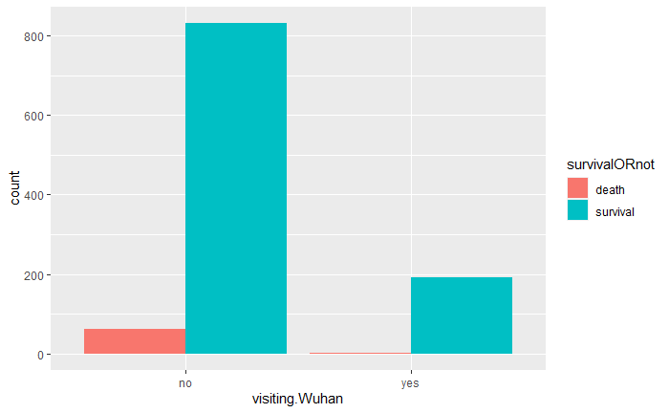
CORRELATION BETWEEN THE OUTCOME AND CATEGORICAL VARIABLES
P-Value: 0.0005564678
Death/Survival VS Visiting Wuhan

Slide 17
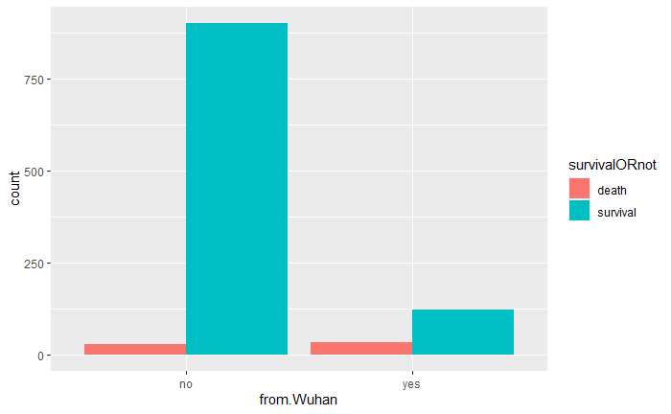
CORRELATION BETWEEN THE OUTCOME AND CATEGORICAL VARIABLES
P-Value:
2.756613e-20
Death/Survival VS From Wuhan

Slide 18
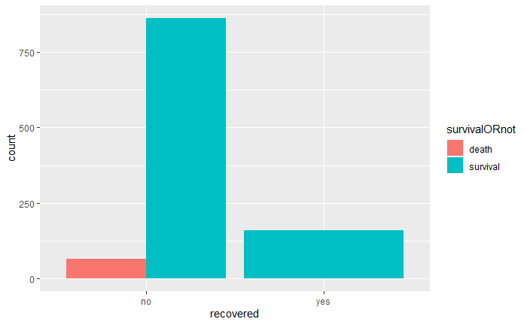
CORRELATION BETWEEN THE OUTCOME AND CATEGORICAL VARIABLES
P-Value: 0.0007018556
Death/Survival VS Recovered

Slide 19
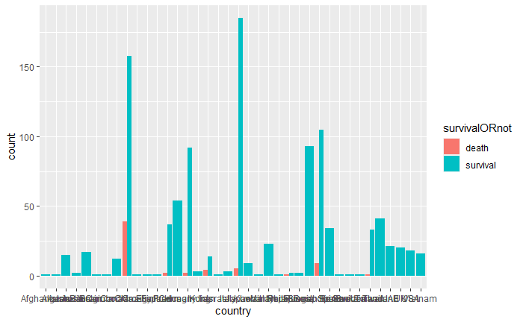
CORRELATION BETWEEN THE OUTCOME AND CATEGORICAL VARIABLES
P-Value:
5.841393e-10
Death/Survival VS Country

Slide 20
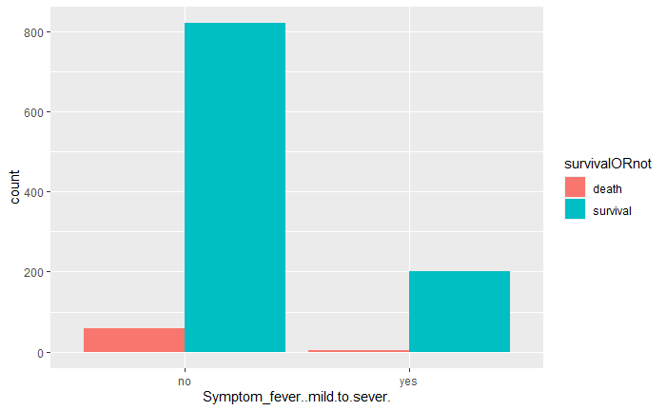
CORRELATION BETWEEN THE OUTCOME AND CATEGORICAL VARIABLES
P-Value:
0.008410168
Death/Survival VS Fever(Mild to Sever)

Slide 21
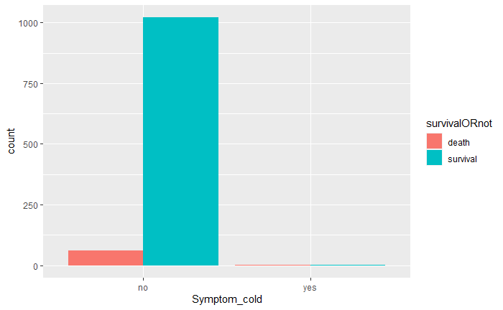
CORRELATION BETWEEN THE OUTCOME AND CATEGORICAL VARIABLES
P-Value:
0.00747502
Death/Survival VS Cold

Slide 22
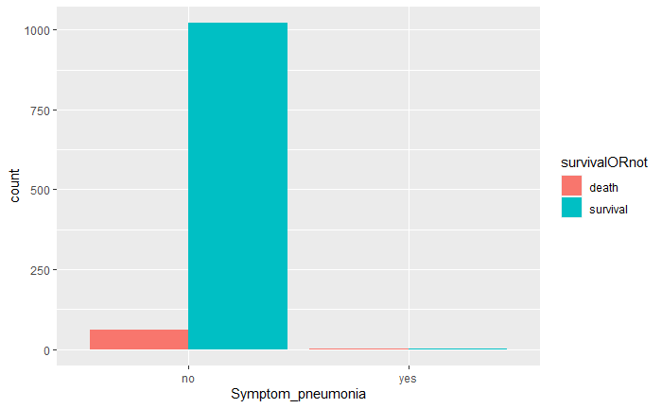
CORRELATION BETWEEN THE OUTCOME AND CATEGORICAL VARIABLES
P-Value:
6.371671e-06
Death/Survival VS Pneumonia

Slide 23
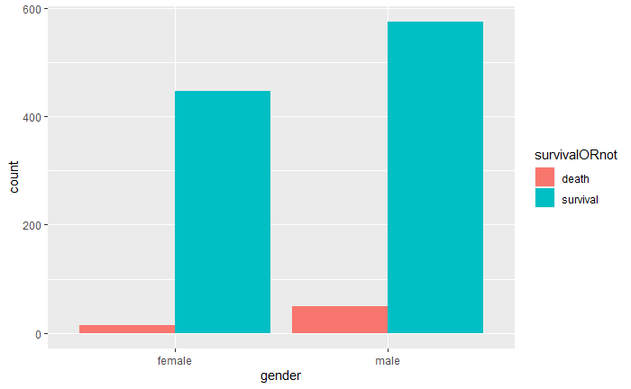
CORRELATION BETWEEN THE OUTCOME AND CATEGORICAL VARIABLES
P-Value: 0.0007997044
Death/Survival VS Gender

Slide 24
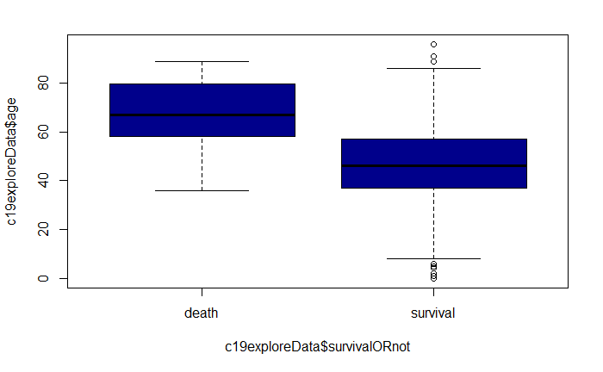
CORRELATION BETWEEN THE OUTCOME AND NUMERIC VARIABLES
P-Value:
2.423e-16
Death/Survival VS Age

Slide 25
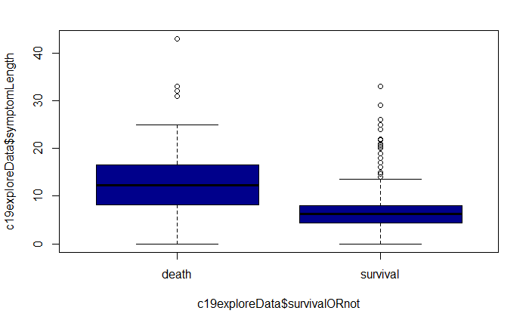
CORRELATION BETWEEN THE OUTCOME AND CATEGORICAL VARIABLES
P-Value:
2.195e-09
Death/Survival VS Length of Symptom

Slide 26
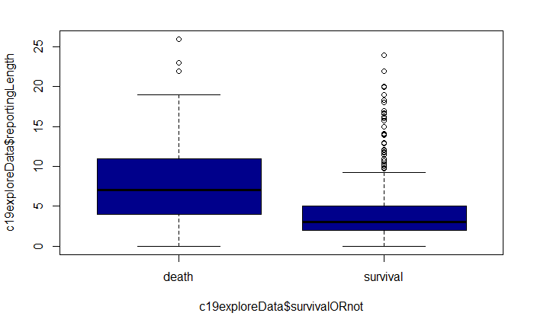
CORRELATION BETWEEN THE OUTCOME AND CATEGORICAL VARIABLES
P-Value:
3.164e-07
Death/Survival VS Reporting Length

Slide 27
FURTHER DATA PROCESSING ON ANN AND ONE-CLASS SVM

Slide 28
FURTHER DATA PROCESSING ANN
We split the data into 80% training and 20% testing then 90% training and 10% validation
We then converted the categorical variables to numeric and scaled all of our numeric data.
We then scaled our numeric validation data on the standard deviation and mean of the training data
This step is then repeated on the original training and testing data

Slide 29
FURTHER DATA PROCESSING ONE-CLASS SVM
We started by converted the categorical variables to numeric and scaled all of our numeric data.
We convert our outcome variable to TRUE and FALSE where TRUE(1) is survival and FALSE(0) is death
We split the data into 90% training and 10% testing

Slide 30
BALANCING DATA USING SMOTE

Slide 31
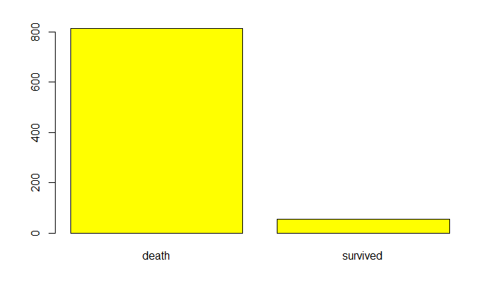
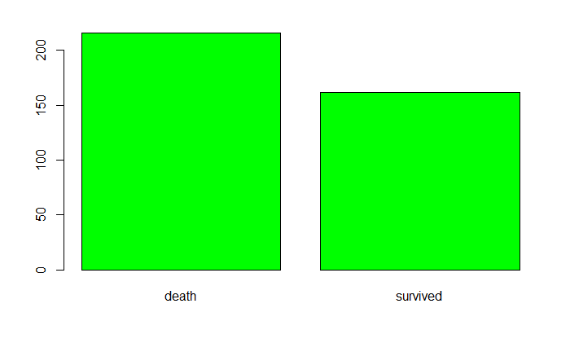
BALANCING DATA USING SMOTE
Death VS Survival after splitting data
Death VS Survival after applying SMOTE on training data

Slide 32
03
TRAINING MODELS

Slide 33
ALGORITHMS USED
Regularized Logistic Regression
Lasso Regression
Ridge Regression
Elastic Net Regression
Tree Ensemble Models
Random Forest Model
Gradient Boosted Tree Model
K Nearest Neighbor
Artificial Neural Network
Anomaly Detection methods
Isolation Forest
One-Class Support Vector Machines

Slide 34
VARIABLES LASSO DIDN’T SHRINK
countryChina
countryFrance
countryHong Kong
countryIran
countryJapan
countryPhillipines
countrySingapore
countrySouth Korea
countrySwitzerland
countryTaiwan
countryThailand
countryUAE
gendermale
age
If_onset_approximated
visiting.Wuhan
recovered
symptomLength
reportingLength
Symptom_fever..mild.to.sever.
Symptom_coughing..mild.to.sever.
Symptom_chills
Symptom_diarrhea
Symptom_pneumonia
Symptom_sputum
Symptom_myalgia
Symptom_sore.throat
Symptom_dyspnea

Slide 35
LEVEL OF IMPORTANCE BY RANDOM FOREST MODEL FROM LEFT TO RIGHT
Age
from.Wuhan
reportingLength
symptomLength
countryMalaysia
countryChina
Recovered
countrySouth Korea
Gendermale
countryThailand
Symptom_sputum
Symptom_pneumonia
Symptom_sore.throat
countrySingapore
Symptom_fever..mild.to.sever.
countryJapan
Symptom_diarrhea
countryTaiwan
countryUAE
visiting.Wuhan

Slide 36
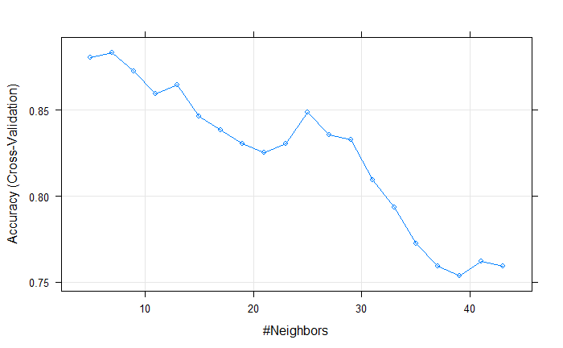
TUNING OF KNN
K – 7 gives the highest accuracy

Slide 37
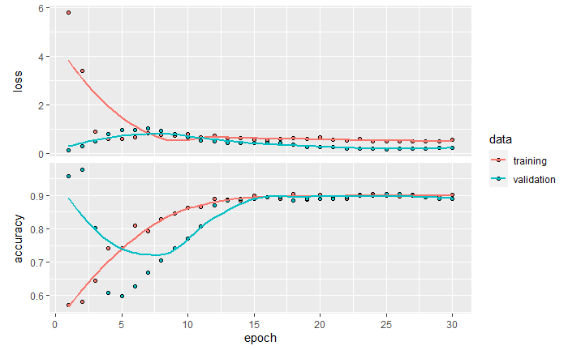
ANN – TRAINING AND TEST BASED ON BEST FLAGS
node1 392, batch_size 500, activation relu,
learning_rate 0.001, epochs 30, dropout 0.5 and nodes2 392

Slide 38
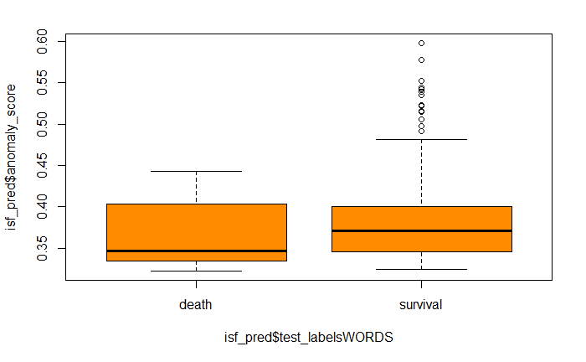
ISOLATED FOREST
DEATH/SURVIVE VS Anomaly Score

Slide 39
04
RESULTS

Slide 40
RESULTS

Slide 41
CONCLUSION
We noticed that some algorithms produced very good accuracy; however, we received very poor false negative rates.
Random forest seems to be relatively the best choice as it gives the highest accuracy, kappa, AUC and a low FNR compared to other algorithms.
SVM gives a low FNR, it also gives a low AUC and accuracy and an average kappa based on the other algorithms.
With a better dataset, we could improve the outcome of all algorithms as we wouldn’t have to deal with imbalanced data.
Reference
Prediction 0 1
0 203 2
1 5 7
Random Forest Confusion Matrix

Slide 42
REFERENCES
[1] Naming the coronavirus disease (COVID-19) and the virus that causes it. (n.d.). Retrieved May 1, 2020, from https://www.who.int/emergencies/diseases/novel-coronavirus-2019/technical-guidance/naming-the-coronavirus-disease-(covid-2019)-and-the-virus-that-causes-it
[2] Li Yan, H.-T. Z., Goncalves, J., Xiao, Y., Wang, M., Guo, Y., Sun, C., … Yuan, Y. (2020, January 1). A machine learning-based model for survival prediction in patients with severe COVID-19 infection. Retrieved May 1, 2020, from https://www.medrxiv.org/content/10.1101/2020.02.27.20028027v3
[3] Pourhomayoun, M., & Shakibi, M. (2020, January 1). Predicting Mortality Risk in Patients with COVID-19 Using Artificial Intelligence to Help Medical Decision-Making. Retrieved May 1, 2020, from https://www.medrxiv.org/content/10.1101/2020.03.30.20047308v1
[4] DataVedas, & *, N. (n.d.). UNSUPERVISED ANOMALY DETECTION. Retrieved May 1, 2020, from https://www.datavedas.com/unsupervised-anomaly-detection/

Slide 43
THANK YOU!

